Slide 1
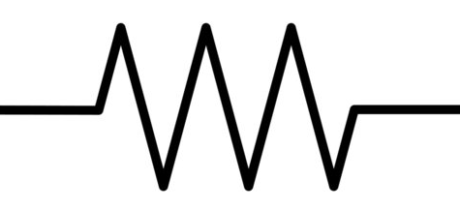
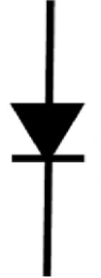
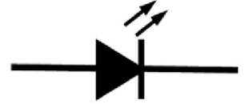
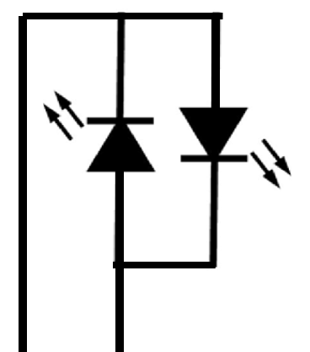
DCC K
Current Limiting Resistor (on the PCB)
Rectifying diode (on the PCB)
Local Led (on the PCB)
Input Led in the solid state relay and bypass connection (on the PCB)
SPDT switch (remote)
Back to Back LEDs as ground signal (remote)
DCC J

